Slide 1

Airline Management

Slide 2

Team Members.
Shiwangani Jaiswal (NU 002749421)
Shreyas Dasari (NU 002743612)
Sampada kasture (NU 002743809)

Slide 3

Problem Statement
People who are planning for a vacation, will look for a flight which provides various features like book flight, cancel flight, make payments.
Airline Management usually concentrates only on managing bookings of the flight, Medical emergency, Security and flight crew.
Airline management system will provide the financial and business solution on one platform.

Slide 4
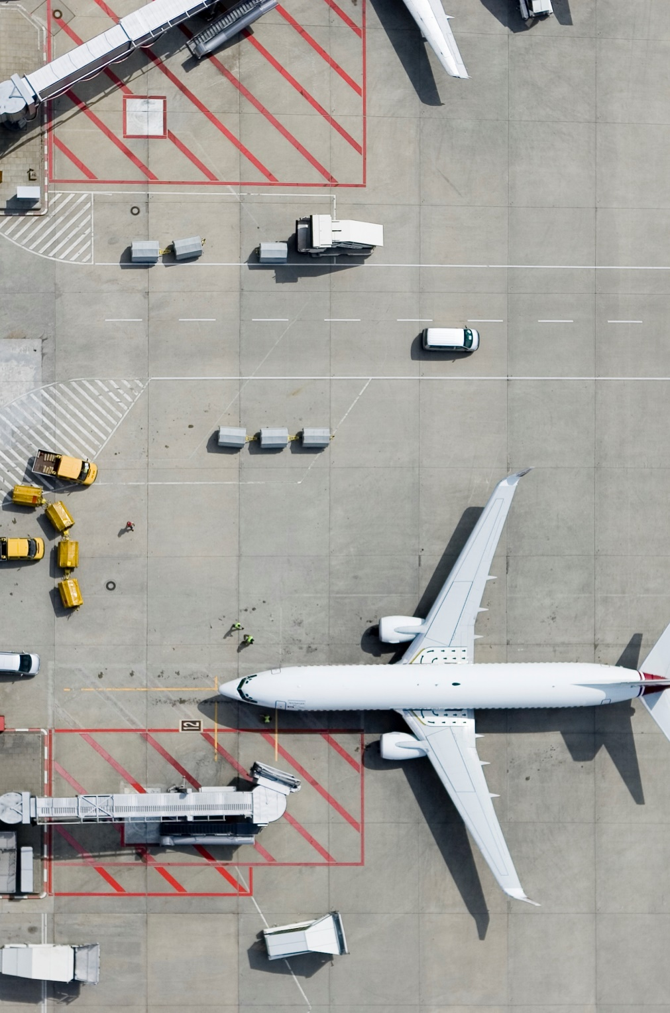
Project Objective.
Airline management is a user-friendly graphical interface helps users to interact with the system and meet their requirements in just few clicks. Its reservation management tool helps you to keep updated information and providing the customers a cutting-edge technology for their journey session.
The user can modify the security question and password as well as buy the ticket. User can access medical information and examine bills in an emergency.

Slide 5
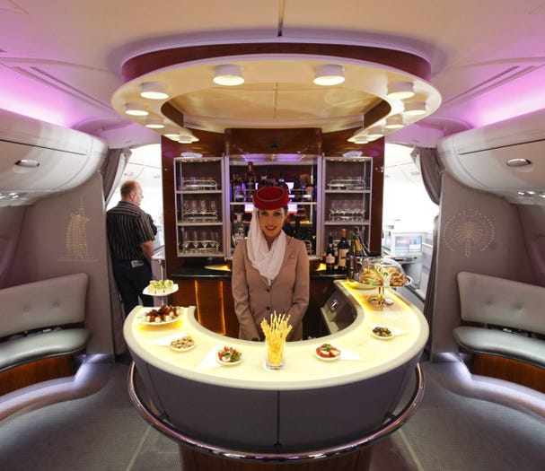
Area to focus.
Airline Management will help to enhance their resort features keeping in mind the demand.
Customers demand will always be our main concern and we will be focusing on providing the right resources to our customers.
Airline will manage Passenger details , Staff details, Medical emergency and Security operation.

Slide 6

Thank You

